Slide 1
s2
eth2
s3
eth1
eth2
eth1
eth2
eth2
h1
eth1
s1
s4
eth1
h2
eth1
eth1
eth3
eth3
s5
eth1
eth2

Slide 2
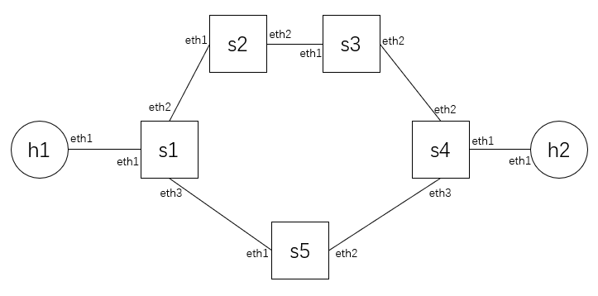
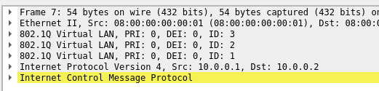

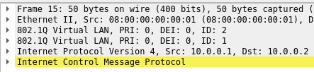

h1 ping h2
Path: h1 - s1-s5-s4 - h2
Out port: eth3-eth2-eth1 = [3, 2, 1]

Slide 3
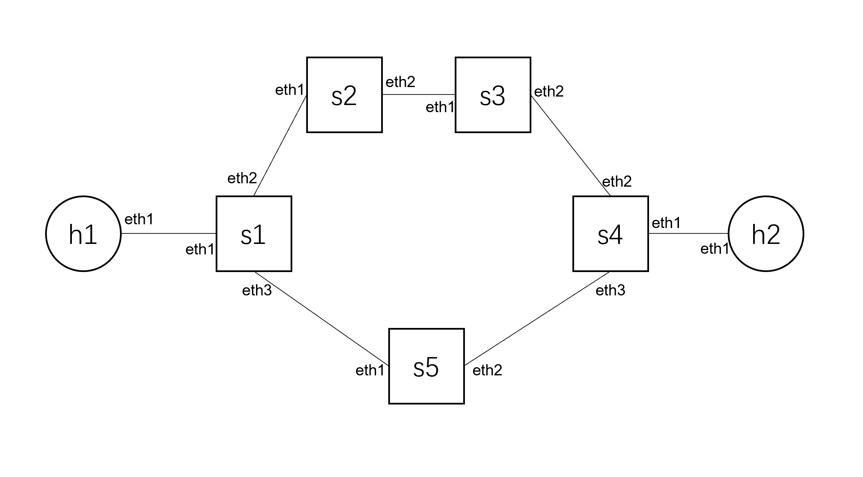
s1 flow table
cookie=0x0, duration=39.239s, table=0, n_packets=88, n_bytes=5280, priority=65535,dl_dst=01:80:c2:00:00:0e,dl_type=0x88cc actions=CONTROLLER:65535
cookie=0x0, duration=39.240s, table=0, n_packets=10, n_bytes=460, priority=2000,dl_vlan=1 actions=pop_vlan,output:"s1-eth1“
cookie=0x0, duration=39.240s, table=0, n_packets=7, n_bytes=406, priority=2000,dl_vlan=2 actions=pop_vlan,output:"s1-eth2“
cookie=0x0, duration=39.240s, table=0, n_packets=3, n_bytes=162, priority=2000,dl_vlan=3 actions=pop_vlan,output:"s1-eth3"
1: LLDP automatic
2, 3, 4: forward pkt to the corresponding port AND pop vlan tag

Slide 4
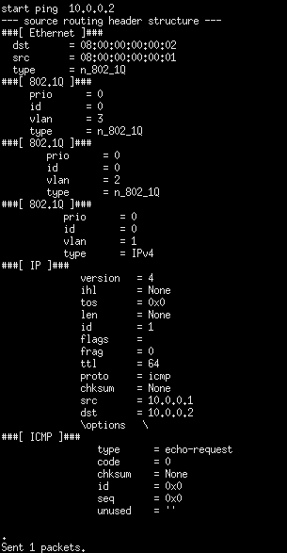
h1 ping h2
Pkt header structure
In native mininet, ping is without source routing headers.
Hosts need an extra scapy script to edit headers.

Slide 5
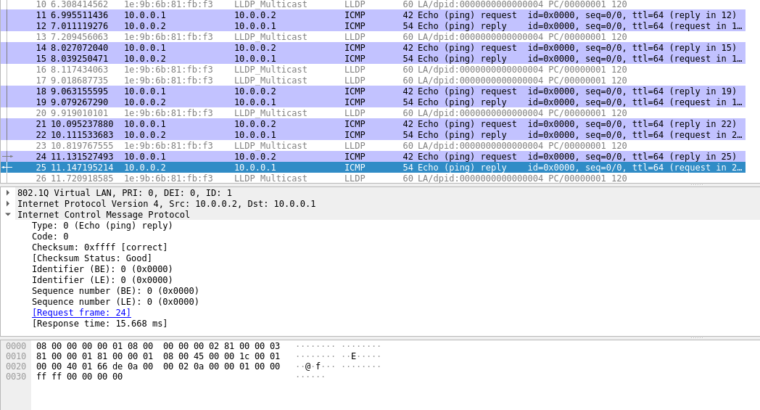
ICMP ping reply
Also done by a scapy script.

Slide 6
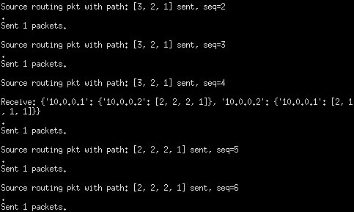
Controller can send messages to hosts (every n seconds)
Use openflow Packet-Out feature
Via UDP port 9999
Hosts need scapy scripts to continuously listen to controller
h1 sends continuously ping
Send pkt with path s1-s5-s4 (out port 3-2-1)
Receive new path from controller
Send pkt with path s1-s2-s3-s4 (out port 2-2-2-1)

Slide 7
Topology interface: json dictionary
topo = {
Host1 IP: {
Dst1 IP: [port path Host1 to Dst1],
Dst2 IP: [port path Host1 to Dst2],
...
},
Host2 IP: {
Dst1 IP: [port path Host2 to Dst1],
Dst2 IP: [port path Host2 to Dst2],
...
},
...
}
# Example:
topo = {
"10.0.0.1": {
"10.0.0.2": [3, 2, 1]
},
"10.0.0.2": {
"10.0.0.1": [3, 1, 1]
}
}

Slide 8
Improvement
Now we send topo to hosts every n seconds.
We don’t need to send the same thing all the time.
Keep monitoring topo (every 0.5s)
Only send topo info if it changes.
Other question: Is ping each other enough for the project?
Do we need else like TCP connection?

